Slide 1
THE IMPACT OF DIGITALIZATION ON RURAL WOMEN'S PARTICIPATION IN FEMINIST MOVEMENT BUILDING AND ORGANIZING IN UGANDA; A CASE STUDY OF ZOMBO DISTRICT BY
HOPE ATIM & IMMACULATE MUKASA

Slide 2
BACKGROUND
As the world becomes more digitalized, the internet has become a powerful tool for feminists and activists to organize, amplify voices, advocate for change and foster global solidarity and sisterhood. Everywhere in Africa, Feminists have been leveraging on the reach of technology such as social media to mobilize support, hold trainings, conduct campaigns to drive social change, speak against Gender Based Violence (GBV) and all forms of discrimination against women and girls. Whereas this has been a powerful tool for feminist organizing, movement building and enabling women’s voices to be heard amidst the shrinking civic space especially in Uganda, It has also had an excluding effect on rural women who are not in position to use the different digital platforms and equipment (Gargets).

Slide 3
It’s against this background that the Mentoring and Empowerment Programme for Young Women (MEMPROW) conducted this study to understand the impact of digitalization on rural women's participation in feminist movement building and organizing in Paidah sub county Zombo district, Uganda.
This paper highlights our findings on the level of participation of rural women on the digital platforms especially in regards to feminist organizing, connection, advocacy for women’s rights and mobilization for feminist engagement. The study also explores the challenges they face in participating in feminists online organizing and movement building activities. It also establishes strategies on how to ensure inclusive digital participation of rural women in feminist movement building and organizing.

Slide 4
OBJECTIVES
To find out how rural women are utilizing the digital platforms to connect, advocate, and mobilize as feminist.
To find out the challenges faced by rural women in participating in feminists online organizing and movement building activities.
To establish strategies on how to ensure inclusive digital participation for rural women in feminist movement building and organizing.

Slide 5
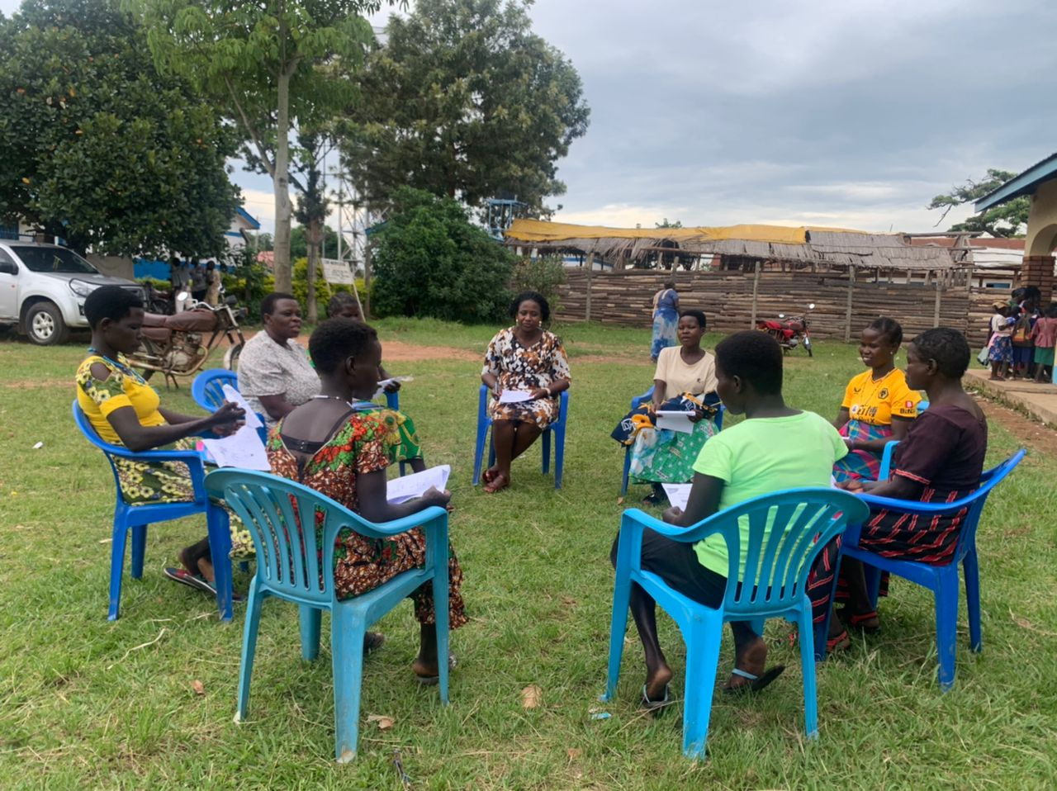
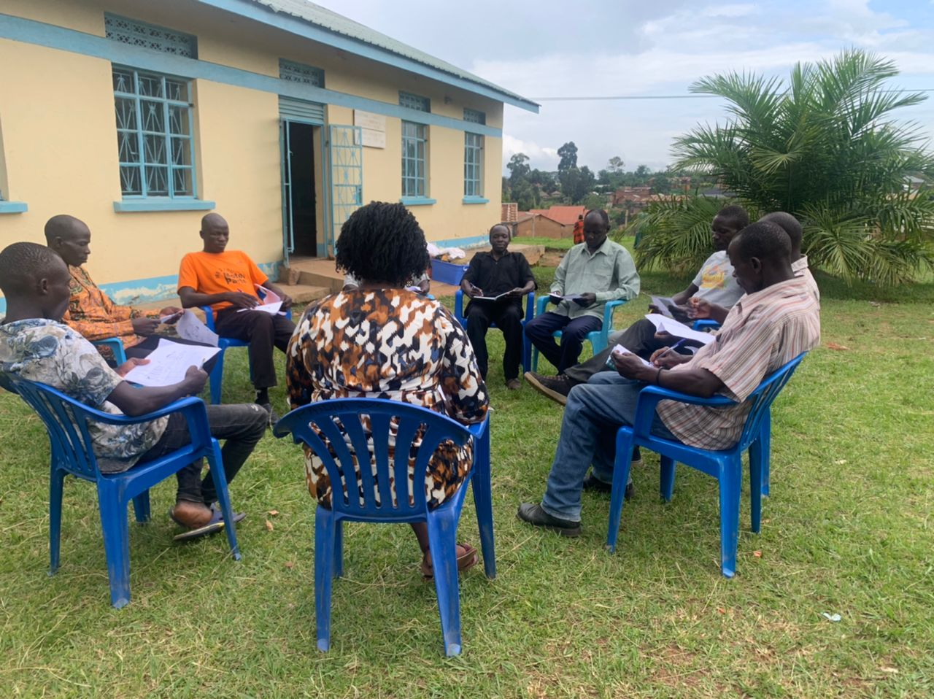
METHODOLOGY
Mixed method approach
Focus Group Discussions (FGD) with women and girls aged 18- 45 years.
4 FGDs ( each group consisted of 8-10 women )
Key informant Interviews (KII) for specific people such as women leaders, women advisors, local activists, cultural leaders and religious leaders.
One on one interviews
Tracked our online engagements ( twitter spaces, zoom meetings , google meetings)
The sampled people also suggested strategies on how to ensure inclusive digital participation for rural women in feminist movement building and organizing

Slide 6
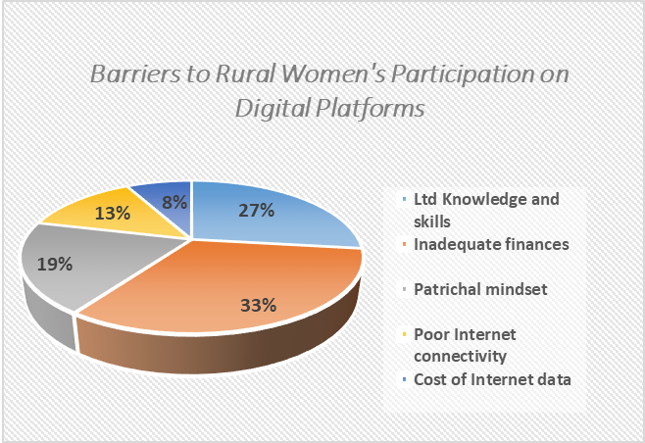
RESULTS
Our findings were as follows;
Generally low participation of rural women on digital platform
There were several challenges or forms of barriers to rural women’s participation in online feminist organizing, and these ranged from:
Structural barriers, economic , social & mind set
the biases about digital platforms (whatsapp, facebook, zoom, google) to low education levels, unemployment and lack of finances to purchase digital gargets.
Limited knowledge and skills on how to engage online. ‘Using technology demands high level of knowledge and skills which lacks in most rural women’ according to one of the respondent. Most rural women are not aware about the existence of digital platforms.

Slide 7
Patriarchal societal structure/ men’s power over women in the community does not allow women to embrace and learn technology. One of the respondents attested that regressive culture, stereotypes and negative perceptions about women’s role has been a great limitation as “ most men have smart phones but would not buy for their wives because of fear, that they would chat with other men’’
It was shared in the KII interviews that the few rural women who own smart phones generally lack relevant knowledge to join digital platforms such as twitter spaces, zoom meetings and digital campaigns. was noted to affect rural women’s participation in feminist movement building. ‘’Most rural women
Inadequate finances to buy digital gargets do not own digital gadgets like phones because they can’t afford them’’.
Poor internet connectivity in the rural areas also affects rural women’s participation in digital spaces.
Power outage and no electricity in most rural areas of Zombo district
The cost of data to join online feminist engagements makes it hard for many rural women to participate.

Slide 8
RECOMMENDATIONS
Digital literacy, There is need for empowerment of rural women with digital knowledge and skills to promote and literacy of women and girls to effectively participate in feminist movement building.
Empowerment of women through Income Generating Activities (IGA) and increasing employment opportunities for women will increase their incomes and their ability to afford the cost of internet data.
The cost of devices/gargets and data must be regulated and made affordable for average Ugandans to purchase.
Advocacy for policy Taxation policy change in Uganda must be revised ie double taxation on mobilie money and data

Slide 9
CONCLUSIONS
Digitalization has potential to transform feminist organizing and movement building, it’s a powerful tool for feminists and activists to organize, amplify voices, advocate for change and foster global solidarity and sisterhood in the continuously shrinking civic space. It’s therefore important that the digital gender gaps and challenges that rural women experience are addressed to ensure inclusive participation of all women and girls even for the most disadvantaged groups. In this era of technology advancement, achieving gender equality is very crucial and will need empowerment of rural women with digital knowledge and skills to promote the literacy of women and girls to effectively participate in feminist movement building.

